Slide 1
CIS117 Week 4
More commands and switches

Slide 2

Using switches
Sentence structure
Commands switch argument
Case matters!
Common ls switches –l –a –R –la (combined switches)
https://www.learnenough.com/command-line-tutorial

Slide 3
Find
Search using find (or locate)
find –name myfile (basic)
find /etc –name passwd (within a folder)
find –name “*.txt” (search by extension)
find –iname testfile (case insensitive find)
Groups, user, file type, dirdctory, empty files, date, last access etc.

Slide 4

Wildcards
* any number of characters
? Single character
[aA] sets
https://warosu.org/g/image/tghUwtRrOEpxDRdelXpaag

Slide 5
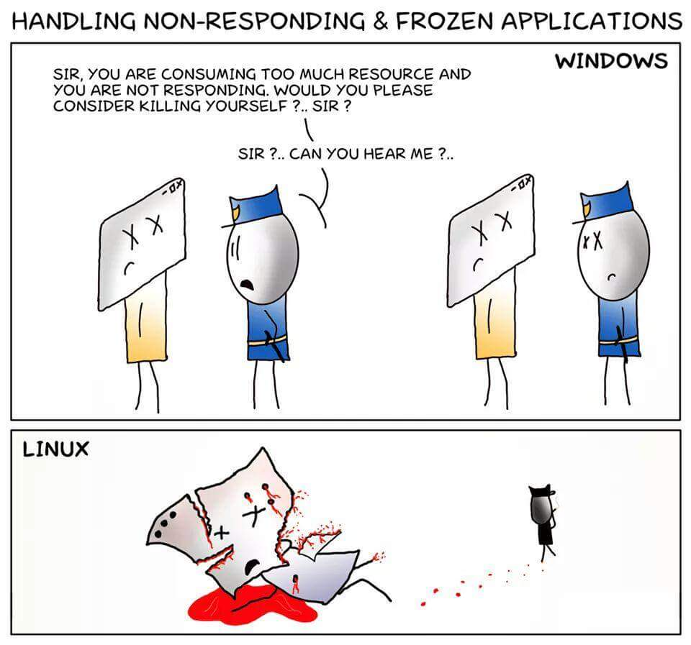
Processes
ps and ps –a
ps –fu username
Killing processes
kill -9
https://www.reddit.com/r/linuxmasterrace/comments/3y42qz/killing_a_nonresponding_process/

